Slide 2
IBC MISSION: We exist to mobilize and multiply disciple-making churches.
It is our deep desire that we join our missionary God in what He is already doing in the world, recognizing that He is sending us together with many others.

Slide 3
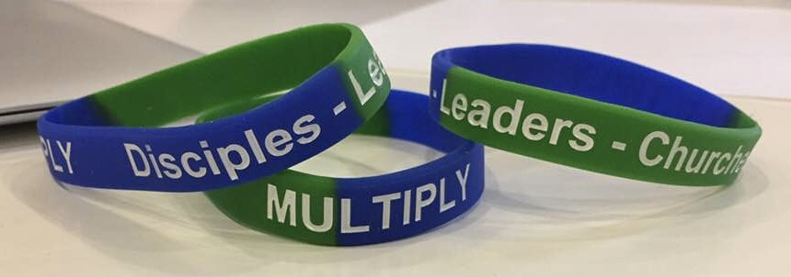
IBC VISION: We envision a movement of global-minded churches that are reproducing healthy disciples, leaders, and congregations.
stimulating churches toward mission advancement.
helping churches to keep their focus on making and multiplying disciples.
developing pastors and leaders in essential ministry skills.
becoming a catalyst for strategic church-planting.
nurturing a spirit of love that bridges cultures, nationalities, ethnicities, generations, politics, privilege, position, and religious backgrounds.
fostering fellowship and connections among pastors and churches.
supporting churches in times of need and transition.

Slide 4
Our CORE VALUES define us as an international family of churches and drive all our decisions and ministries.
We value Partnership. We believe that working together with other churches to reach common goals enriches churches. Every church has something to offer.
We value Healthy Churches. We believe that the local church is God’s primary means of presenting the Gospel and establishing His kingdom
We value Church Planting. We believe that every church should be involved in some way in helping to start new congregations.

Slide 5
2012 - CIF Darmstadt, GE - LEAD Team
2012 - Lifebridge Panama City, Panama - LEAD Team
2012 - Tamarindo CR - LEAD Team
2015 - RIC Rome, Italy - LEAD Team
2016 - Koinonia Int’l Christian Fellowship, Aalborg, DK
2016 - Waypoint Kaiserslautern - Frontline Community, GE
2018 - GLACE Church Vicenza, Italy - LEAD Team
2018 - IBC Bonn - IBC Cologne, GE
2018 - EIC Ternes Paris - EIC Rueil Paris, France
2018 - Multination London - Multination Frankfurt, GE
IBC Church
IBC Church
IBC Church
LEAD TEAM
IBC Church
IBC Church
New Church

Slide 6
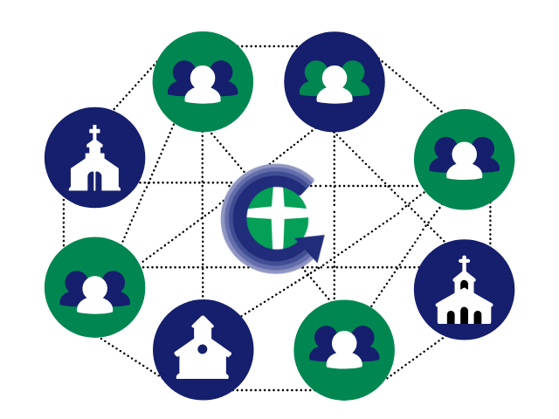
Church Multiplication Networks

Slide 7
Church Multiplication Networks
New Church
New Church
New Church
New Church
New Church
New Church

Slide 8
Church Multiplication Networks
Multiplication Highlights!
What’s going on now?

Slide 9
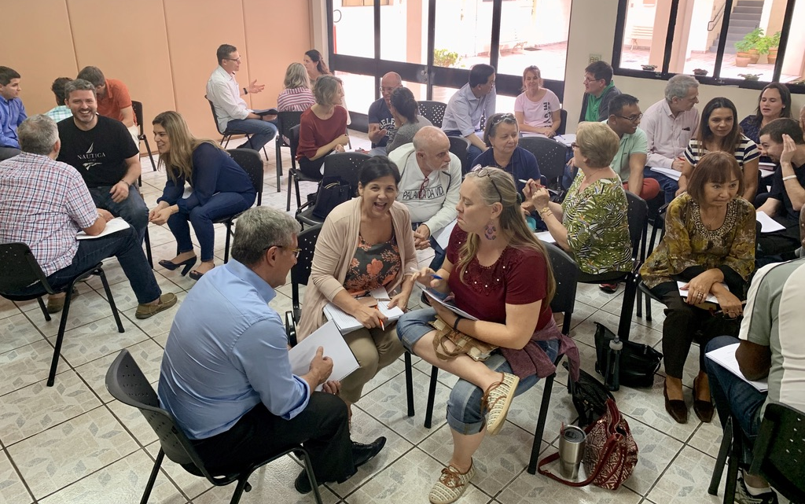
Church Multiplication Networks
Coming in May:
Disciple Making
Church Planting
Make disciples to plant churches?
Plant churches to make disciples?
What does a church plant look like?

Slide 10
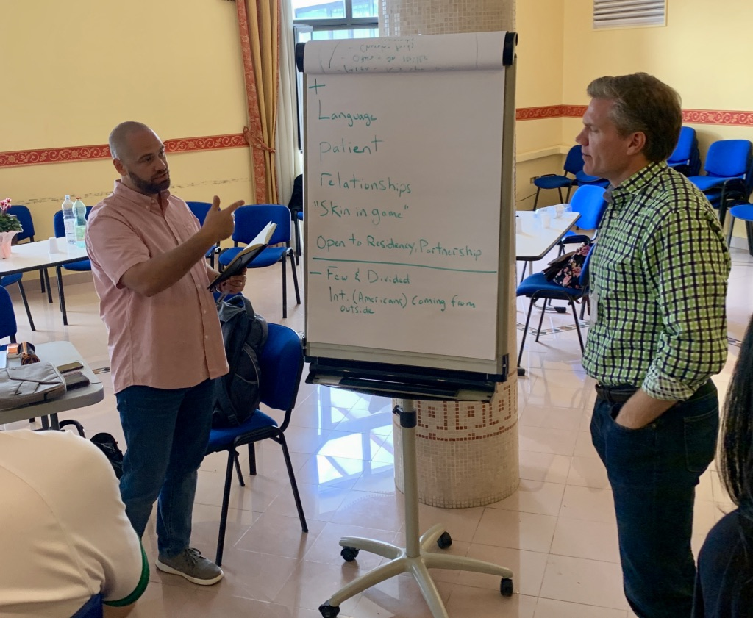
Church Multiplication Networks
Coming in June:
Partnership
Better Together!
Partnership Opportunities:
Feasibility Studies
Assessments Centers
Training Events
Residency Programs
More!

Slide 11
Church Multiplication Networks
Coming in July:
Leadership:
People Development
Tools we can use right now!
Make a difference today!

Slide 12
Church Multiplication Networks
Thanks for joining us!

