Slide 1



Slide 2
We exist to mobilize and multiply disciple-making churches.
As a family of churches, it is crucial that we clearly define the mission to which God has called us. Mission answers the question, “What does God want us to accomplish?” Seeking to accomplish our mission will drive us to achieve our purpose of bringing glory to God. It is our deep desire that we join our missionary God in what He is already doing in the world, recognizing that He is sending us together with many others.

Slide 3
We envision a movement of global-minded churches that are reproducing healthy disciples, leaders, and congregations.
We see the convention as a servant to the churches. In other words, we exist to serve the churches and not the other way around. We see the local church as central to the plan of God. Our role is to help “mobilize and multiply” churches that are carrying out their mission “to make disciples.”

Slide 4
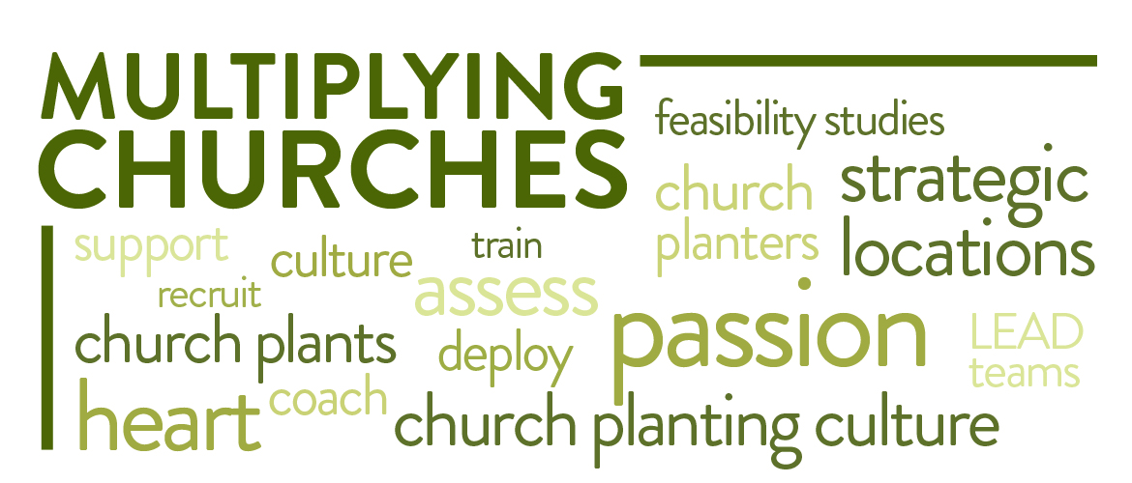
Multiplying churches
We believe church multiplication should be at the core of our energies and also at the heart of every congregation’s efforts and passion. We want to facilitate a movement of multiplying English-language disciple-making churches in strategic locations.

Slide 5
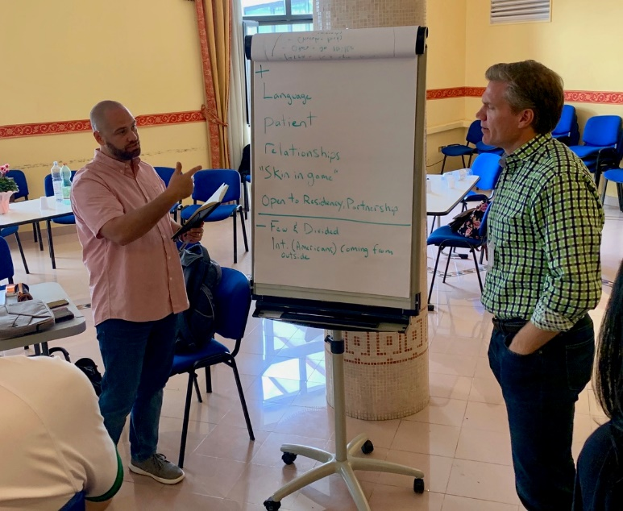
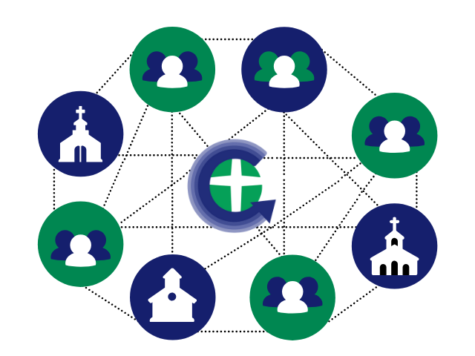
Multiplying churches
2019-2020
Church Planter Assessment Center, Naples, Italy
Church starts in Paris (Ternes), France; London, England; and South Frankfurt, Germany
CMNs launched

Slide 6
26 April 2020. That was the day we hoped to see our plans and prayers come to fruition. On that Sunday, River of Life Church was to hold its very first Sunday gathering. Months of planning were about to be realized…and then in an instant…everything changed. In late March Germany announced countrywide restrictions on public gatherings. With that announcement and the indefinite timeline of when and how the corona crisis would move forward, one thing was certain, River of Life Church would not proceed as we planned.
Sam dyer
Church planter
south Frankfurt, germany

Slide 7
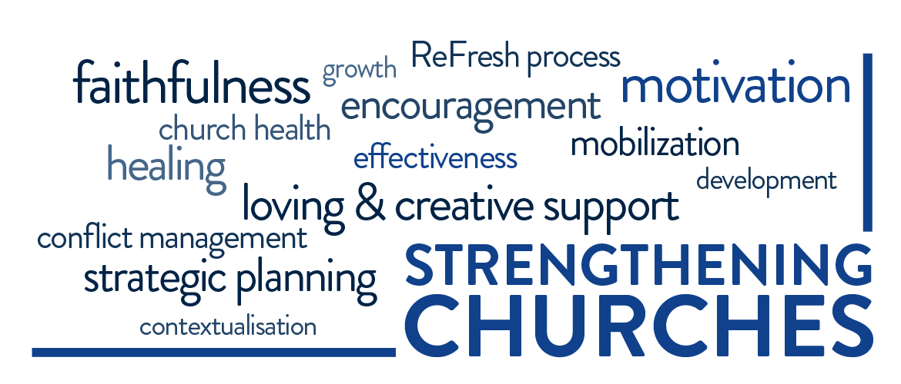
strengthening churches
We believe God wants every church to be healthy, moving toward faithfulness and effectiveness. We want to encourage and strengthen healthy churches to continue on their path. We wish to help churches desiring to take needed steps toward improved health and growth. We desire to provide appropriate, loving, and creative support and motivation to churches that are weak, unhealthy, or ineffective.

Slide 8
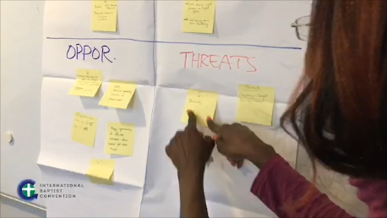
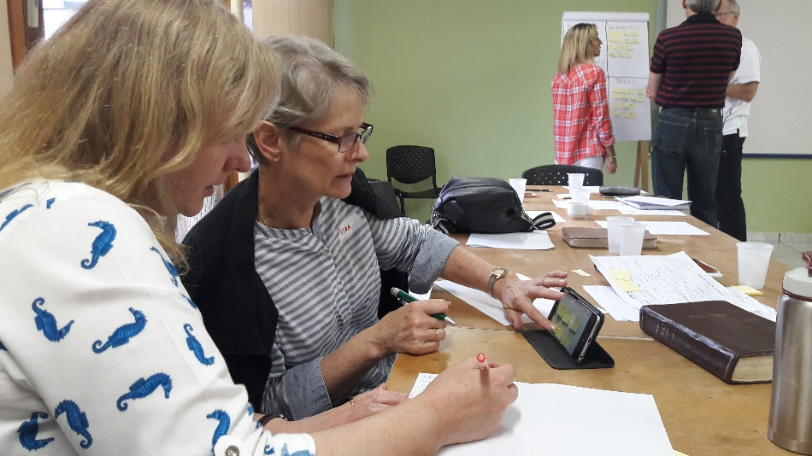
strengthening churches
ReFresh is a process of refocusing the mission of the church, identifying its core values, discovering God’s fresh vision for the church, and building a game plan for living out that vision.
2019-2020
ReFresh revamped for online training

Slide 9
The ReFresh process enabled us to step back from the day-to-day life of the church and examine where God was leading us as a church. The external facilitator allowed us to mould the process to suit our individual church situation, whilst maintaining a structure and direction which ensured that something useful came out of the exercise. It gave an opportunity for a wide range of people – beyond the recognized church leadership – to participate in finding out where God was leading us. The ReFresh process enabled us to renew our vision for the church in Darmstadt, leading to a (modified) mission statement, a clear five-year plan, and concrete goals for the next 1-2 years.
Adam Williams, elder, cif, Darmstadt, germany

Slide 10
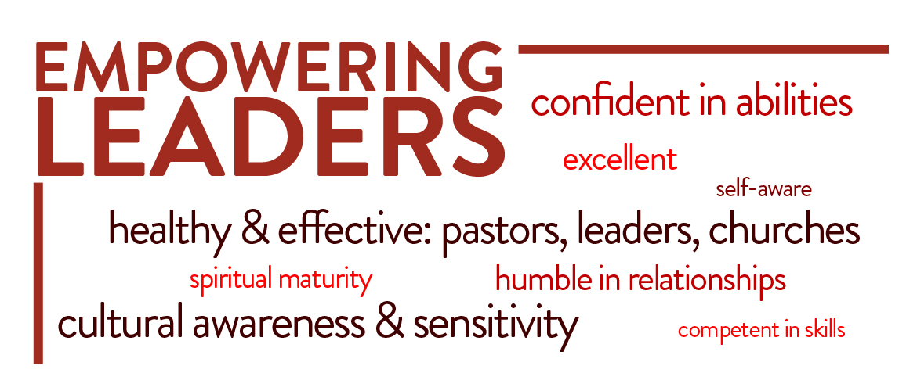
Empowering leaders
We believe healthy, effective pastors and other leaders build healthy, effective churches. We want to produce spiritually mature, self-aware leaders who are competent in their skills, confident in their abilities, and humble in their relationships with God and other people.

Slide 11
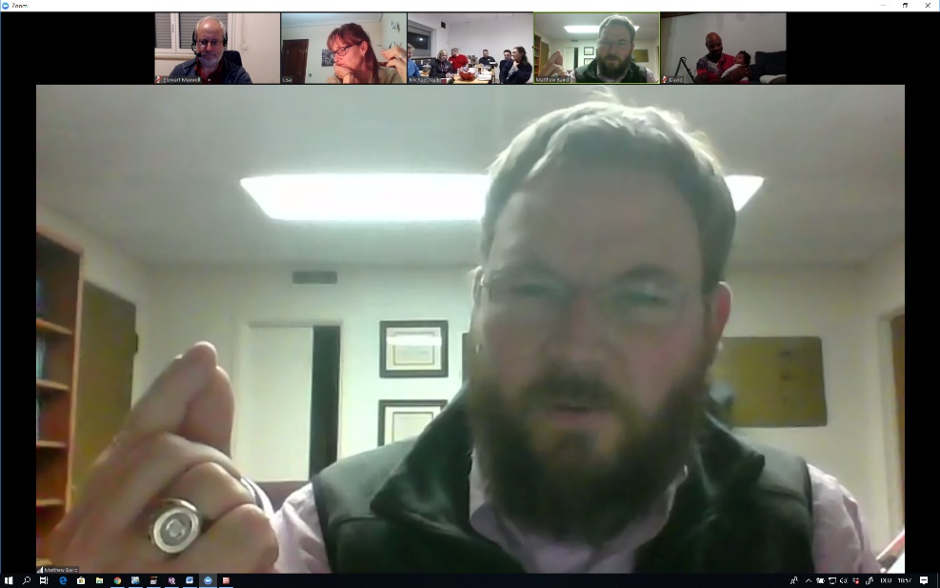
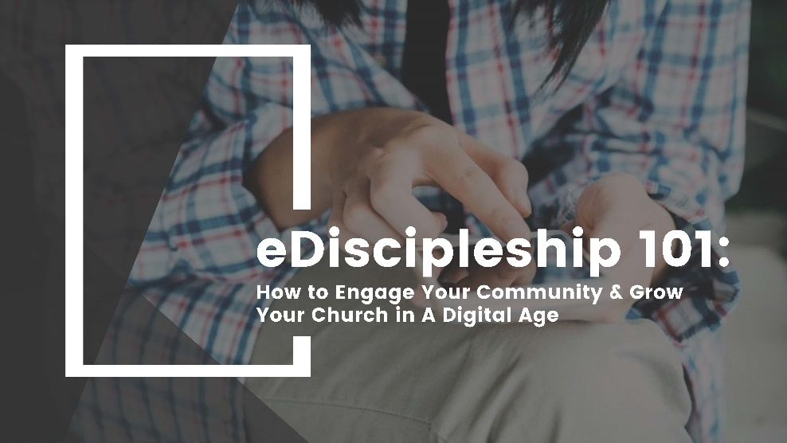
Empowering leaders
2019-2020
B.H. Carroll Institute (seminary training in a local setting)
CORE groups
eDiscipleship 101: How to Engage Your Community & Grow Your church in a Digital Age

Slide 12
“My CORE group experience has been one of the most practical trainings I’ve ever been part of. Working in this small group, I’ve come to better understand my strengths and weaknesses, learning strategies for being more intentional and effective in relationship, which I’ve been able to put into practice in my family, my marriage, and my ministry. I would highly recommend taking part in a CORE group if you have the opportunity.
Jacki Faulkner, Il Faro IBC
Naples, italy

Slide 13
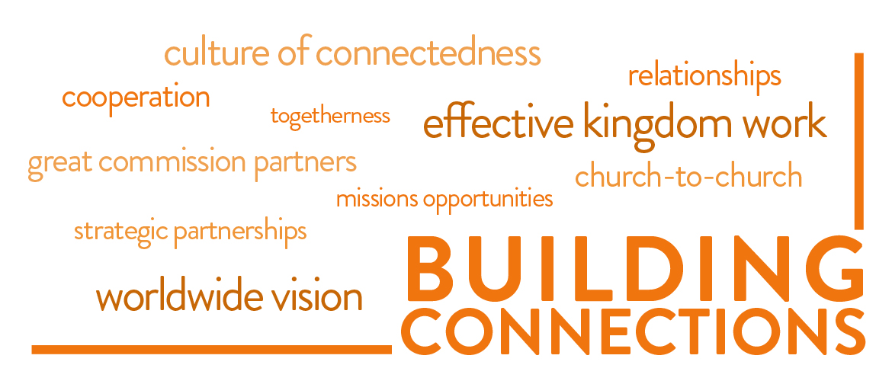
Building connections
We believe deeper relationships are essential for effective kingdom work. We desire to connect IBC pastors and churches with one another. We will also seek to facilitate partnerships between IBC churches and with other Great Commission groups to accomplish God’s global mission.

Slide 14
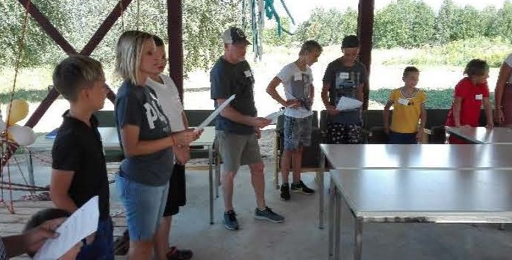
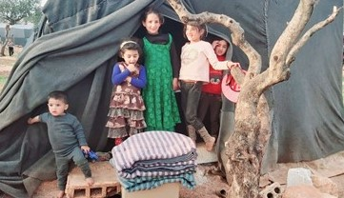
Building connections
2019-2020
Indigenous Church Planters in Latvia and Albania
Missions Project in Turkey
IBC Aid to assist IBC Stuttgart to help Kainos with their anti-trafficking projects

Slide 15
Thank you very much for the difference you will be making in the lives of women and their children! Our mission has remained the same -- God has a new beginning and a new life for every woman and child who has been trafficked. New Life Haus, a home for these women and children, will be a part of this, and no pandemic can stop God's plan!
Lana Packer and the kainos team

Slide 16
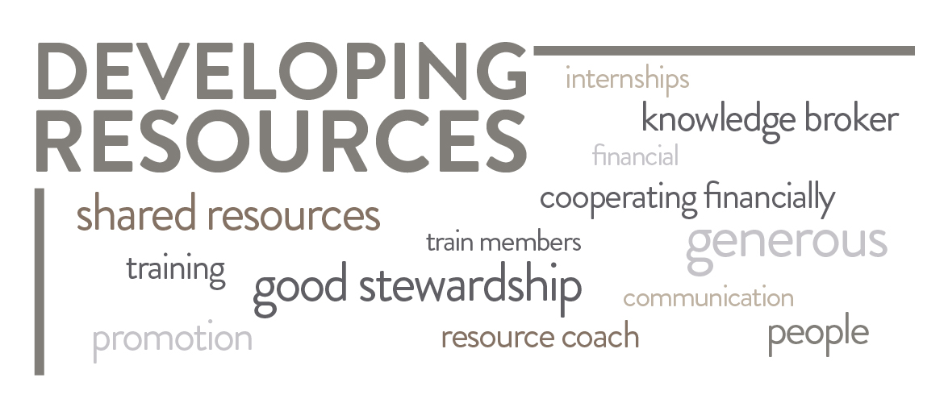
Developing resources
We believe developing resources —financial, people, and training— helps churches and leaders to be effective in their ministry context. We want to become a knowledge broker and resource coach. We wish to assist churches to train members toward good stewardship in order to become financially stable and generous. We desire to assist churches and pastors to understand and appreciate the value of cooperating financially with the IBC so that we can more effectively live out our mission, vision, and values.

Slide 17
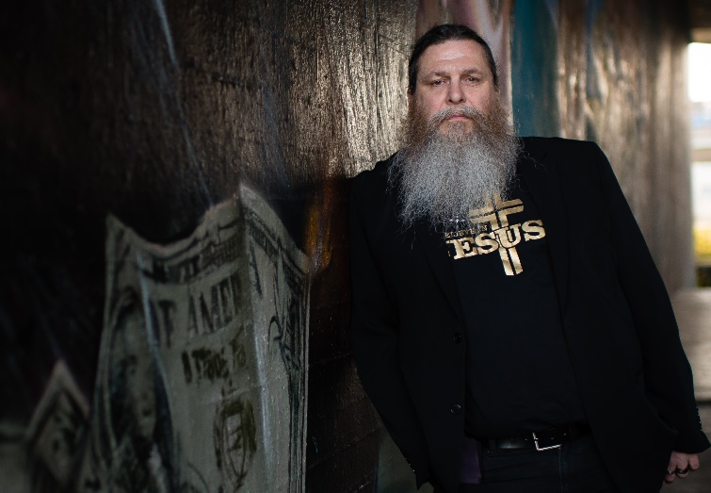
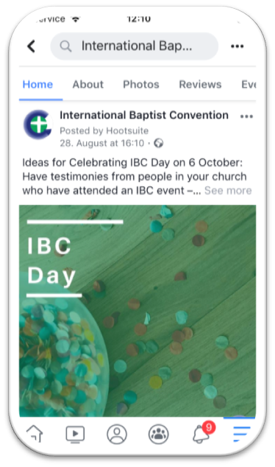
Developing resources
2019-2020
IBC Day
Increased Social Media presence
IBC Residency Program: 2 residents

Slide 18
The IBC's Residency Program has been a key part of our church-planting strategy for Paris, France. Through the program, we've been given accountability in the mentoring process for our residents as well as an outside perspective to advise on tough questions. As a result, we've received helpful coaching on how to equip and train residents for future roles in our church plants. As an added bonus, we've been granted financial help to get residents to the field and to other IBC events. The IBC's Residency Program has helped us do all the things we were wanting to do, but with a greater level of clarity and thoughtfulness than we could have managed on our own.
K.J. Pugh, pastor, eic ternes paris, france

Slide 19
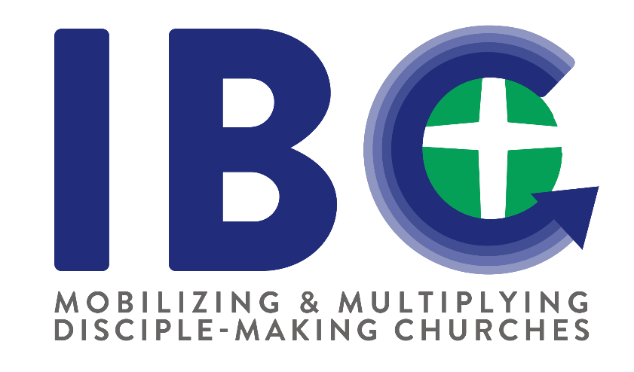
partnership
One of the core values of the IBC is partnership. We value the partnership that we have with each IBC church. We depend on you to support the work we are doing as a family of churches. It is through your giving that we are able to fund the work of Mobilizing and Multiplying Disciple-Making Churches.

